Slide 1

VISUALIZATION OF DISASTER DAMAGES
Group 1

Slide 2
Team Members
Debayan Mandal
Christina Shaw
Andrew Rodgers
Apolonia Hernandez
Zachary Litton

Slide 3
Research Motivation
To build a skeleton framework which can later be used to upload disaster damage related data dynamically which would allow for easier comparison of disaster data.
Help researchers to easily analyze disaster data, whose database can be constantly updated.

Slide 4
Research Objectives
To have a visual representation of different types of damages done by various disasters in Texas on a map and get charts based on the area of study chosen.
Area of study may be chosen as a particular county or state.
Show markers on the coordinates of the counties for which we have data for.
Make a choropleth of the damages when a state is chosen.
For the parameters chosen;
Chart showing the different damages for comparison
Other information for the area chosen
Most frequent disaster
Most damaging disaster

Slide 5
Datasets
National Centers for Environmental Information
Avalanche
Coastal
Drought
Earthquakes
Flood
Fog
Hail
Heat
Wind
Winter Weather
Hurricane/Tropical Storm
Landslide
Lightning
Severe Thunderstorm
Tornado
Tsunami
Volcanic Events
Wildfire
1960-2020 – Compiled by Arizona State University
Notes:
1960-2020 – Compiled by Arizona State University

Slide 6
Datasets (cont.)
U.S. Geological Survey Professional Paper 1527 – Earthquakes
U.S.G.S, U.S.D.A, Media reports – Landslide
Volcanic Hazards: A Source Book on the Effects of Eruptions – Volcanic Events
U.S.D.A – Crop Indemnity Payments

Slide 7
Methods
Leaflet
Javascript
HTML
Inline CSS

Slide 8
Coding View:
HTML file
Javascript File
Data: -
JSON array javascript
Notes:
Alt+tab to files

Slide 9
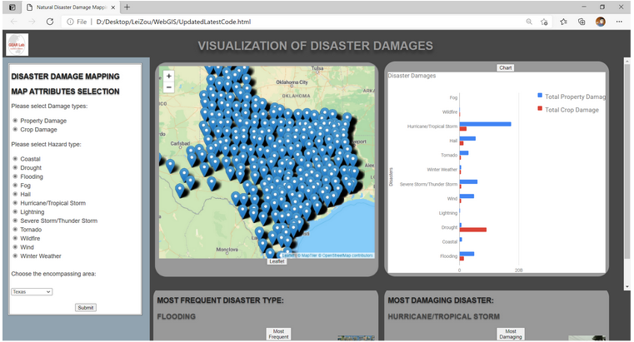
Demonstration:

Slide 10
Discussion
Case Study of Texas:
The most frequent hazard for the given data is Flooding.
The most damaging hazard is Hurricane/Tropical storm.
Chart shows the variation in property and crop damage.
Future work:
Including data from other states.
More styling of the dashboard.
Making the Area field into a typable tag list
Making marker popups scrollable to the next marker.

Slide 11
Challenges
The amount of time required for leaflet to populate the data points markers.

Slide 12
Thank You!

